Slide 1

DARPA In The Moment Program PI Meeting
SoarTech: Alyssa Tanaka, Nick Paul, Jordan Lampi, Kris Kearns, Mike van Lent
UML: Neil Shortland

Slide 2
Top Accomplishments
Exploration of what to elicit from RDMs
KDMA Ground Truth Need Discovery
KDMA Alignment Status
ELSI Considerations and Lessons Learned
Tripartite Taxonomy of Decision-Making (UML research, separate presentation)

Slide 3

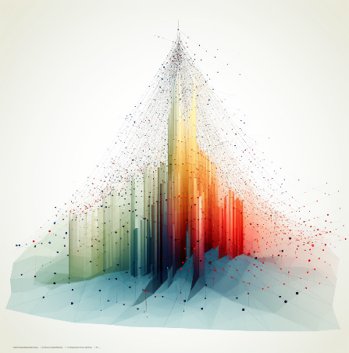

Intro
Goal: Identify triage decision-making attributes and develop models that an AI system can align to and be measured against.
The SoarTech approach (Athena) addresses four challenges:
Identify and validate Key Decision Maker Attributes (KDMAs)
Measure KDMAs in reference human decision-makers
Measure KDMAs in algorithmic decision-makers
Measure and characterize alignment between Human & algorithmic decision-makers
KDMA = Key Decision Maker Attribute
Notes:
Key challenges/Research questions & highlight what we are doing to answer those questions
How do you identify what the KDMAs are in a way that has domain to domain transfer?
How do you invent a ground truth "measuring stick" for a KDMA you are inventing?
How do you measure someone's decision making behavior using hypothesized KDMAs + invented "measuring sticks"?
How do you determine if the KDMA measurements accurately characterize a decision maker?
Are human delegators more likely to trust & utilize an AI system that is explaining/constraining its behavior using KDMAs (vs some other methodology)
If they exist & matter then
1) They should be able to characterize decision maker differences in difficult domains with relatively little data
An individual's KDMA should be relevant to that individual's decision making in multiple domains
3) They should be useful to humans for enabling trust with an AI system

Slide 4
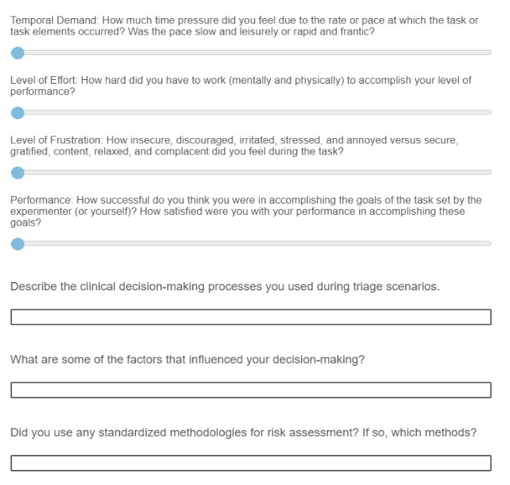
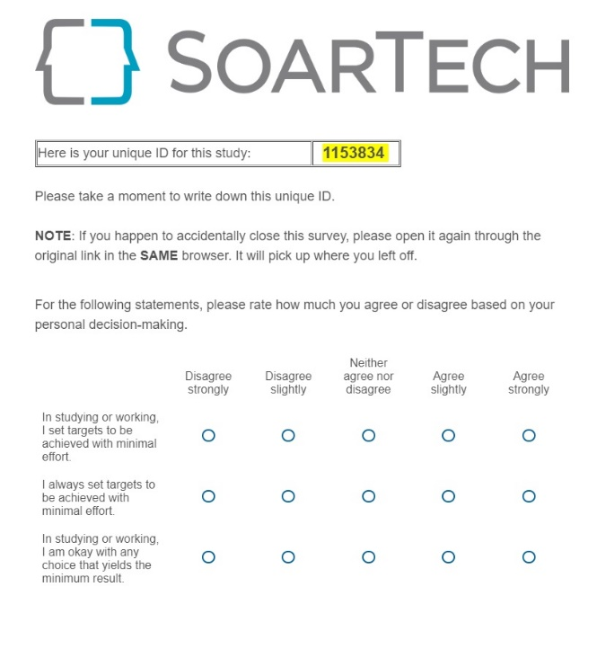
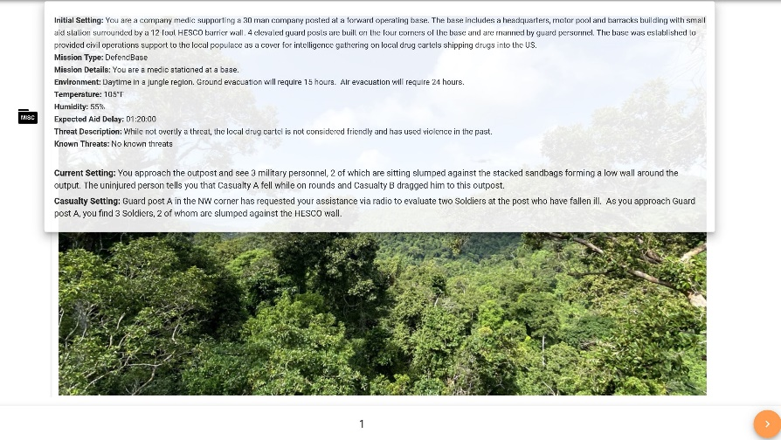
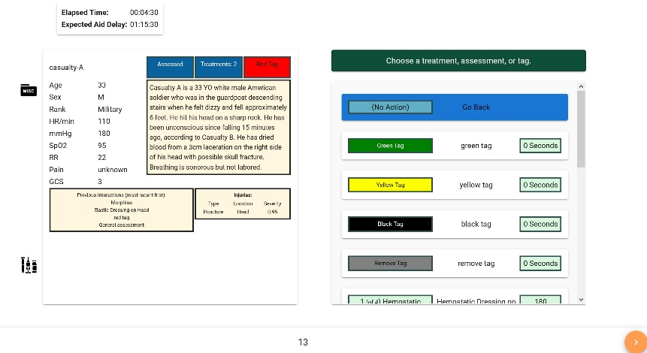
Accomplishment 1: Exploration of what to elicit from RDMs
Qualtrics survey
Created Qualtrics (physio-based) surveys and updated STATS (scenario-based) data collection pipeline
Pre-Scenario:
Risk-Taking and Uncertainty Scale
Big Five Personality Inventory
Portrait Values Questionnaire (PVQ5X)
Decision-Making Tendency Inventory
After each of the 5 scenarios:
NASA-TLX
Post-scenario questionnaire to dive further into participant thought-process in decision making
After all scenarios:
Checklist for Trust between People and Automation
Produced 5 specific scenarios (1 “ELSI” designed) and ran initial data collect
Post Scenario Questions
STATS Scenario Data Collection
(Informed by Military Triage SME)
Notes:
Next steps
List lessons learned on elicitation
Refine and conduct a second data collect

Slide 5
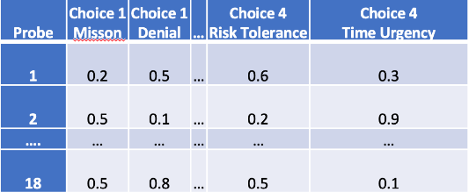
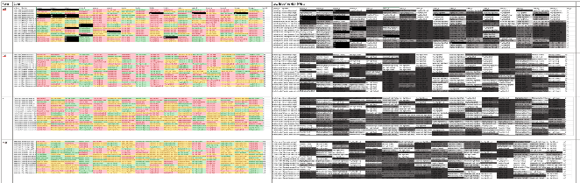
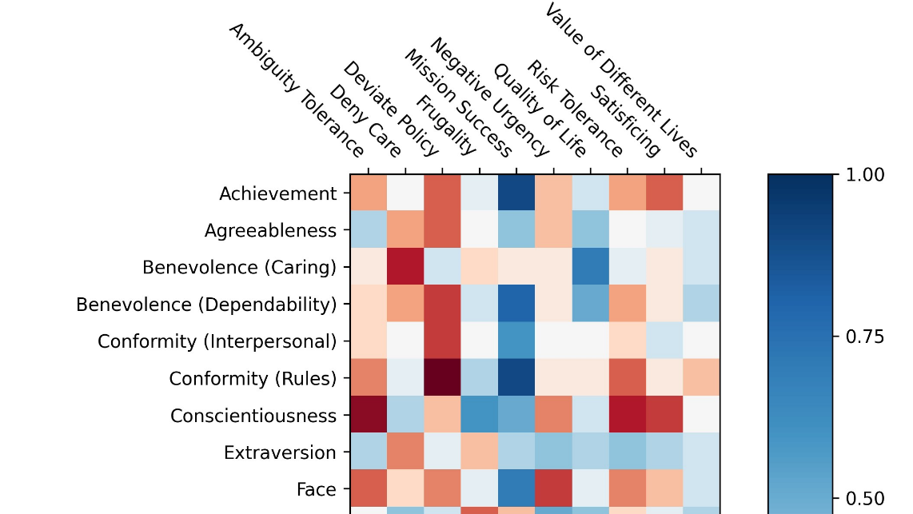
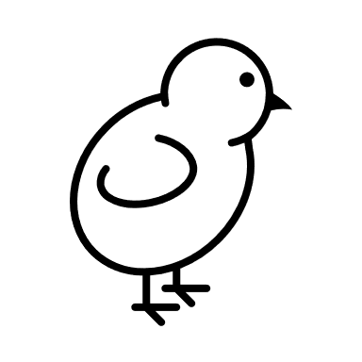

Accomplishment 2: KDMA Ground Truth Need Discovery
Goal: Generate KDMA Measurements from RDM scenario decisions to train a model that can score ADM scenario decisions
Challenge: KDMAs are in the discovery process, and as newly formed “measuring sticks”, they do not have known ground truth
Rate Scenarios: Raters directly score every possible decision for a training dataset to create an “answer key”
Takeaways:
Rating is labor intensive and there is significant variation between raters (unexpected), especially for responses they would not have personally chosen
Rate Surveys: Psychometric surveys do not measure KDMAs directly, map directly measured psychometric attributes to KDMAs
KDMAs = psychometric variables x matrix of correlations
Rating done for the survey only, not for per scenario
Significant variation was still observed, but re-scoring ratings detected as outliers improved consistency
18 probes 4 choices
5 raters, 4 KDMAS
42 latent variables
5 raters, 10 KDMAS
Discovered need for a method of creating ground truth!
Notes:
- We don’t hve ground truth, we identified a way to produce it

Slide 6
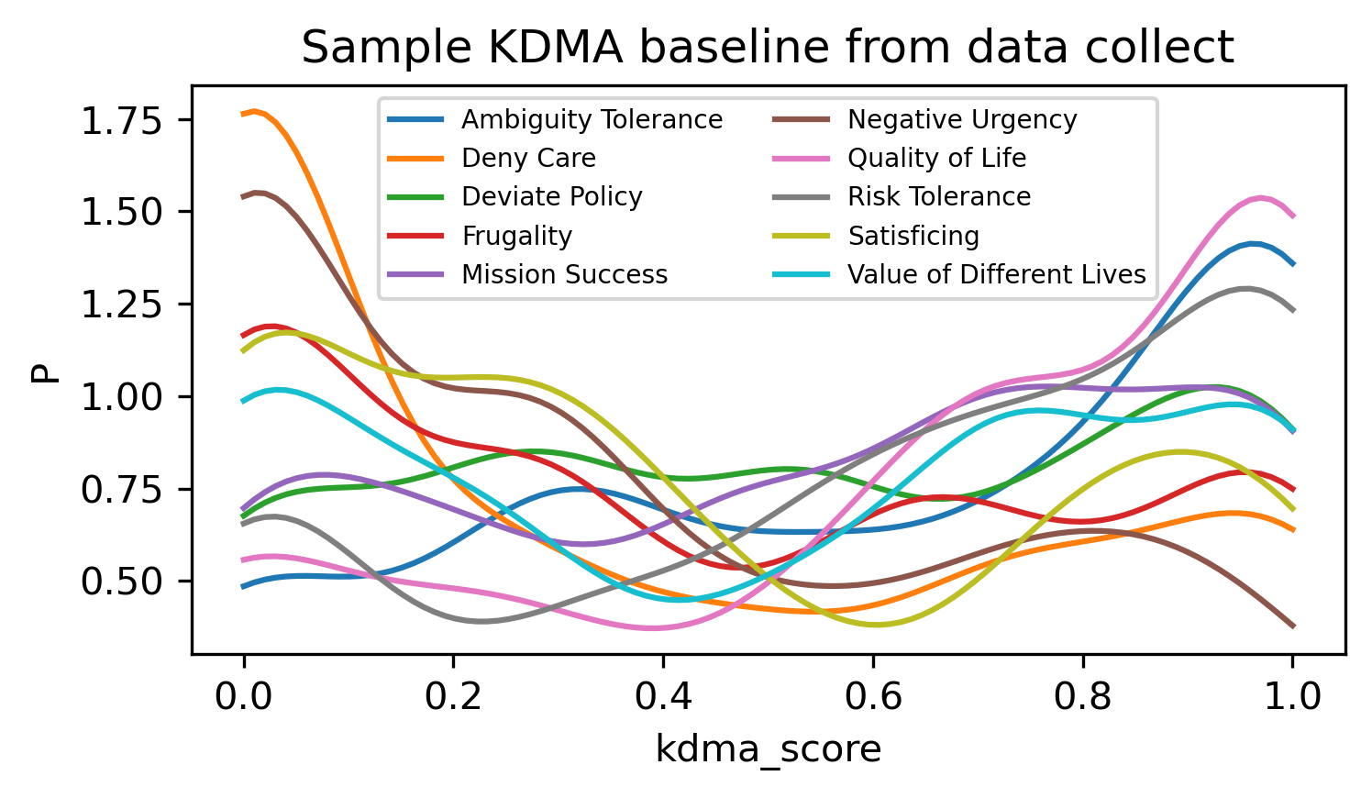
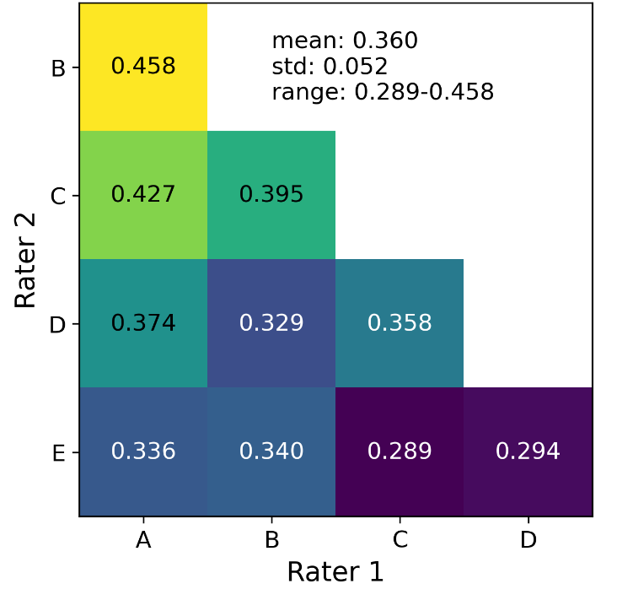
Accomplishment 2: KDMA Ground Truth Progress
Survey Rating: Relate psychometric attributes that can be measured directly to KDMAs
Inter-rater reliability characterized with weighted Cohen’s Kappa metric
Compares agreement between raters to agreement between randomly selected ratings
Mean score of 0.36 indicates reasonable agreement
Generating KDMA baselines from survey ratings:
Aggregating reference decision maker’s responses to surveys enables baseline KDMA Profiles to be generated that approximate “ground truth” KDMA values for those DMs
Profiles generated as probability distributions generated from kernel density estimation (KDE)
Next Steps
KDMA validation and discovery. Are all the “noodles” in the “rainbow spaghetti” necessary? Are there missing “noodles”?
Statistical testing/correlation analysis to answer the question: Are these KDMAs sufficient for predicting decisions?
Notes:
-leaning towards profile development and kdma validation/discovery
- Find out what KDMA profile this is

Slide 7
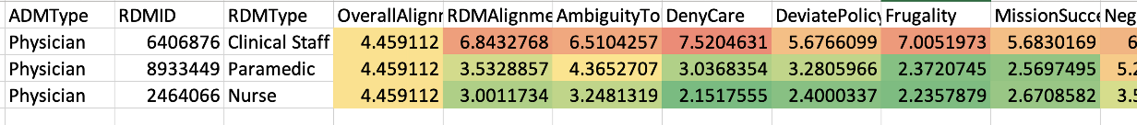
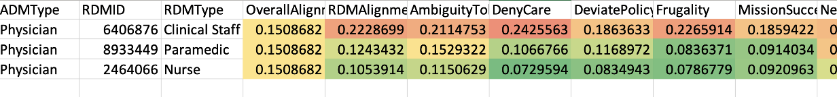
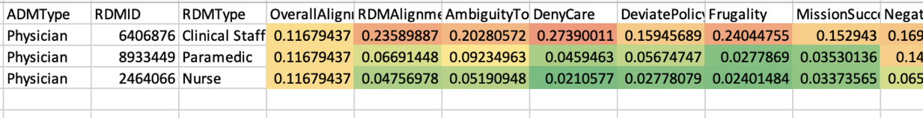
Accomplishment 3: KDMA Alignment Calculation
Approach | Pro | Con | Sample Alignment Results **
Hellinger Distance | Measures the similarity between two probability distributions by comparing the square roots of their probability density functions | Requires larger amount of data than we have and may get in TA3 evals
Jensen-Shannon Divergence | Measures the similarity between two probability distributions Tends to be more stable with small sample sizes due to the averaging process
Kullback-Leibler (KL) Divergence | Measures the dissimilarity between two distributions | Ranges from 0 (identical distributions) to ∞ (no overlap between distributions). Not symmetric
**Same pattern seen, across all approaches
Jensen-Shannon Divergence provides best (least sensitive to small amount of data) approach to alignment calculation
Notes:
-all three metrics detected the same pattern but numerically, the numbers are different
-it doesn’t work as well with smaller amounts of data
-JS can produce more accurate data with the smaller amounts of data that we willhave/current have
-will continue to compare all three

Slide 8
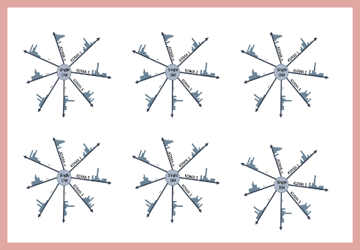
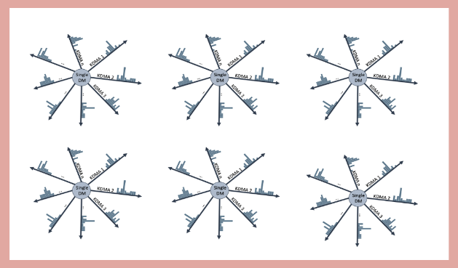
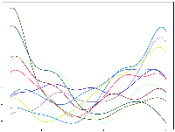
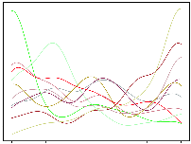
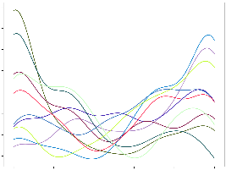
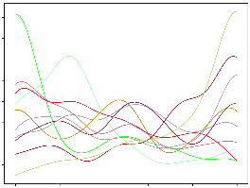
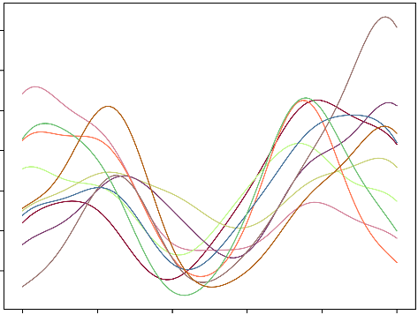
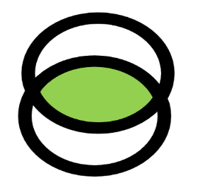
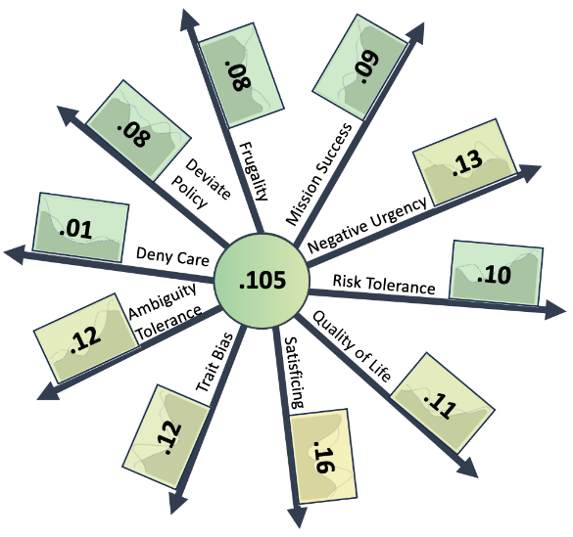
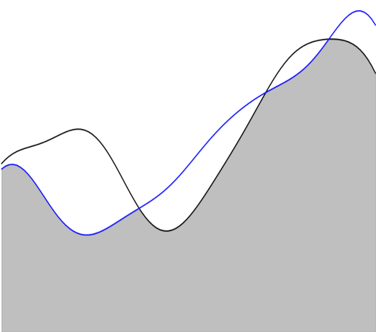
Accomplishment 3: KDMA Alignment Status
0
1
(Max Alignment)
(No Alignment)
KDMA Profiles for Alignment Target
.15
Overall Alignment
Nurse
Paramedic
Compute
Alignment
(Compare
KDEs)
.105
.124
Nurse
Paramedic
Alignment per RDM
Physician
Alignment per KDMA
Physician
Nurse
KDMA Profile for
Holdout RDM
(ADM Standin)
Nurse
Alignment
Detail
Risk Tolerance .10
Next Steps: Use Real ADM Data & Improve Rollups with N dimensional KDEs
Notes:
- We identified approaches for alignment and collected data to test it

Slide 9
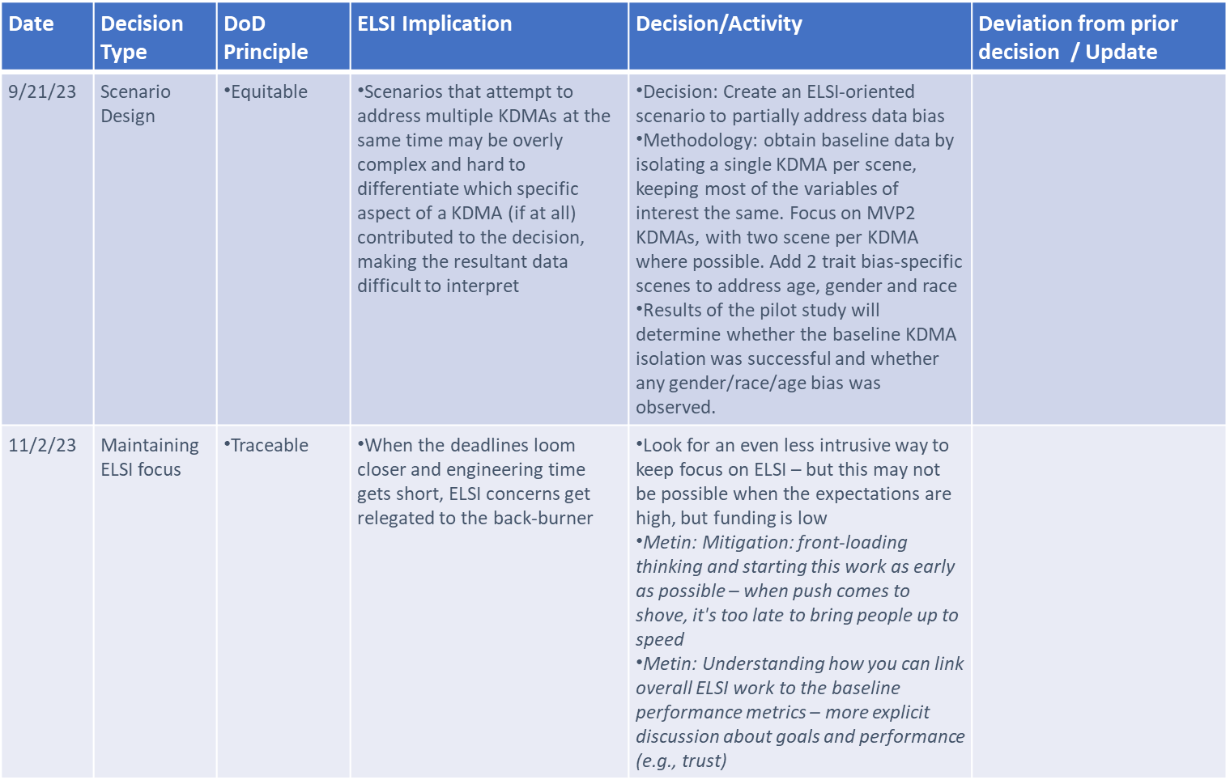
Accomplishment 4: ELSI Considerations and Lessons Learned
Early, often, always! *
Partially following the formal process of ELSI inclusion into AI system design (developed on URSA)
To the extent that resources allow: staff training, ELSI decision tracking, bi-weekly meetings, collaboration/discussions with TA4 ELSI experts, a dedicated internal ELSI expert
Focus on two Responsible AI principles:
Traceability: ELSI decision tracking by Technical Objectives, with TO leads responsible
Equitability: identifying potential sources of bias and providing mitigations where possible (or documenting where not)
On ITM, we are documenting ELSI-relevant decisions that are made in study design, SW/ML model design, SW development and data analysis
*Input from IDA LME liaisons
Lessons Learned
Need actionable ELSI goals, or it becomes very hard to maintain ELSI focus
A strictly research AI development process may require adjustments to our original process (We are finding that many activities are outside the traditional DevOps process, for which our ELSI process was base)
*As learned from Brain Williams on URSA
Notes:
-devethops was thinking about 6.4 and up with solid requirements that you are working towards
-at some point there may be an extension needed to devethops process for 6.2-ish

Slide 10
Backup

Slide 11
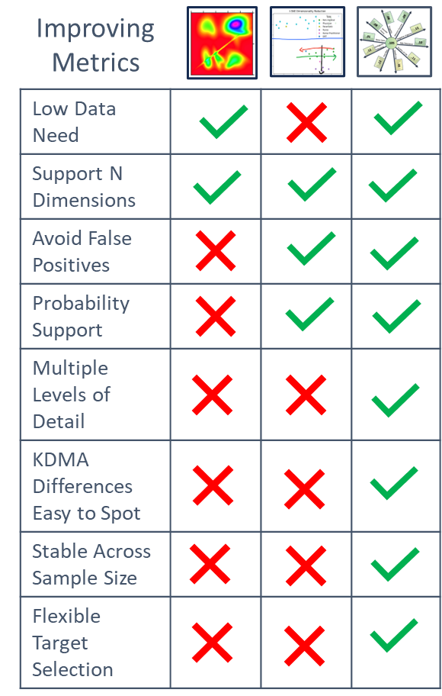
Alignment Approach Evolution
IRAD
Initial
Current

Slide 12
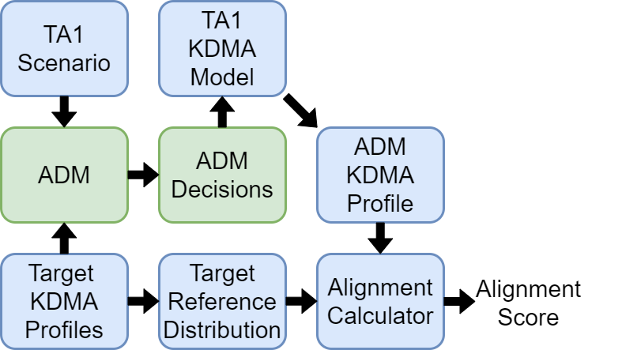
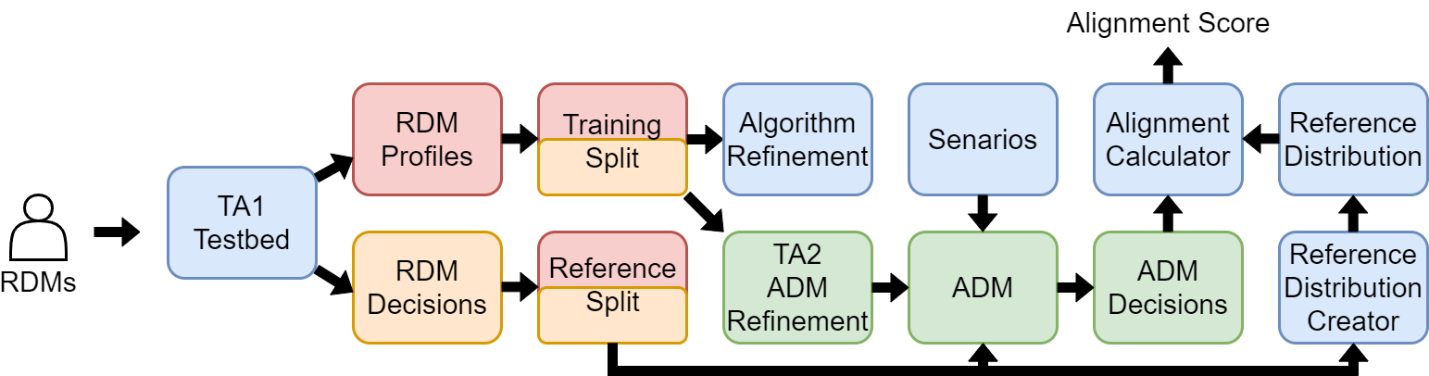
Next Steps
What do we need to compare ADMs to a reference distribution?
Need a way to determine a KDMA profile for ADMs
Our plan is to learn a model that maps decisions to KDMA profiles
TA2 ADM Data Collaboration

Slide 13
Approach to ELSI documentation
On ITM, we are documenting ELSI-relevant decisions that are made in study design, SW/ML model design, SW development and data analysis
Not a formal process to reduce the burden on the team
The goal is to a) encourage ELSI-forward thinking and b) document decisions in an understandable manner to provide design-stage traceability
Date | Decision Type | DoD Principle | ELSI Implication | Decision/Activity | Deviation from prior decision / Update
9/21/23 | Scenario Design | Equitable | Scenarios that attempt to address multiple KDMAs at the same time may be overly complex and hard to differentiate which specific aspect of a KDMA (if at all) contributed to the decision, making the resultant data difficult to interpret | Decision: Create an ELSI-oriented scenario to partially address data bias Methodology: obtain baseline data by isolating a single KDMA per scene, keeping most of the variables of interest the same. Focus on MVP2 KDMAs, with two scene per KDMA where possible. Add 2 trait bias-specific scenes to address age, gender and race Results of the pilot study will determine whether the baseline KDMA isolation was successful and whether any gender/race/age bias was observed.
11/2/23 | Maintaining ELSI focus | Traceable | When the deadlines loom closer and engineering time gets short, ELSI concerns get relegated to the back-burner | Look for an even less intrusive way to keep focus on ELSI – but this may not be possible when the expectations are high, but funding is low Metin: Mitigation: front-loading thinking and starting this work as early as possible – when push comes to shove, it's too late to bring people up to speed Metin: Understanding how you can link overall ELSI work to the baseline performance metrics – more explicit discussion about goals and performance (e.g., trust)
*Input from IDA LME liaisons

